Slide 1
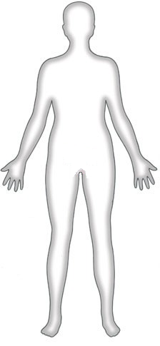
Starter
Water input (ml)
Water output (ml)
Food: 1000
Drink:
Respiration in cells: 300
Exhaled air: 300
Skin (sweat):
Urine: 1350
Faeces: 100
1200
750
Total daily water input: 2500ml
Total daily water output: 2500ml
What are the missing numbers?
Why must water input and output be the same?
You spend the day cycling. Assuming that you eat and drink the same amount as you normally would, what will happen to these numbers and why?
© Snapshot Science, 2012

